Slide 1


Patient appointment management system
1
Name: Sagar Harale
Emp No: 154078
Education: BE (Civil Engineering)

Slide 2
Project description
2
Patient Appointment Booking System according disease.
Doctor can View All The Patients registration and Appointments.
Doctor can reject or accept the appointment.
New Doctors can register if join new Branch .

Slide 3
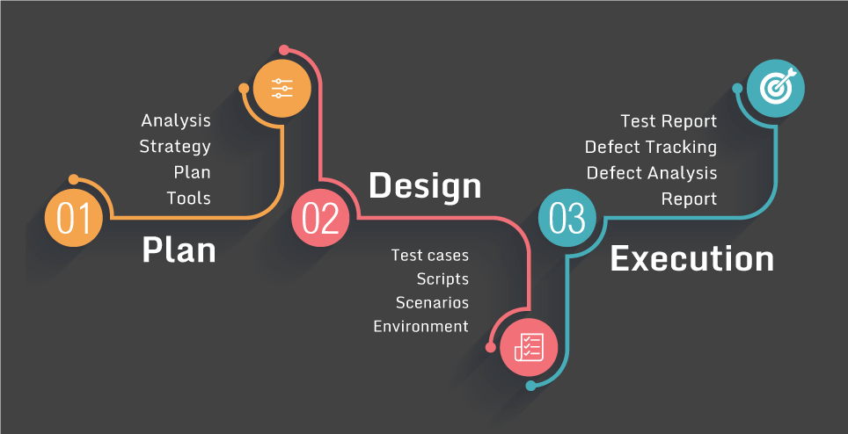
Tools and Technology
3
Tools:
STS Tool, MySQL
Technology:
VS Code, Spring Boot

Slide 4
Thank You
4

